Slide 1
Distributed Systems Presentation
Made by:
Sakshi Vatsa(2k17/CO/296)
Sambhav Jain(2k17/CO/297)

Slide 2
Problem Statement
To design a secure file system which allows distributed system nodes Dsi to access the remote files stored on the remote file servers FSi in a secure manner using RPCs.

Slide 3
Distributed Systems
A distributed system is a software system that interconnects a collection of heterogeneous independent computers, where coordination and communication between computers only happen through message passing, with the intention of working towards a common goal.
The idea behind distributed systems is to provide a viewpoint of being a single coherent system, to the outside world. So, the set of independent computers or nodes are interconnected through a Local Area Network (LAN) or a Wide Area Network (WAN).
Types-
Centralised Architecture
Client/Server Model
Decentralised Architecture
Peer to Peer Systems
Hybrid Architectures

Slide 4
Client/Server Communication
Sockets
a socket is a pair of an IP address and a port number. For two process to communicate, each of them needs a socket.
sockets only allow to transfer unstructured stream of bytes between processes
RPC
In RPC programs call procedures located on other machines
Process on machine A calls procedure on machine B
Calling process on A is suspended, and execution of called procedure takes place on B.
Information is transported from caller (A) to callee (B) in the parameters and is returned back in the procedure result.
Message passing is not visible to programmer.

Slide 5
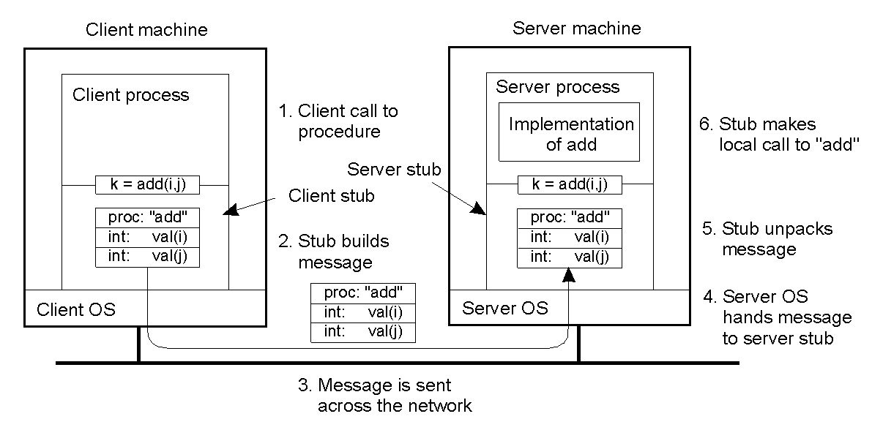
Steps involved in doing remote computation through RPC

Slide 6
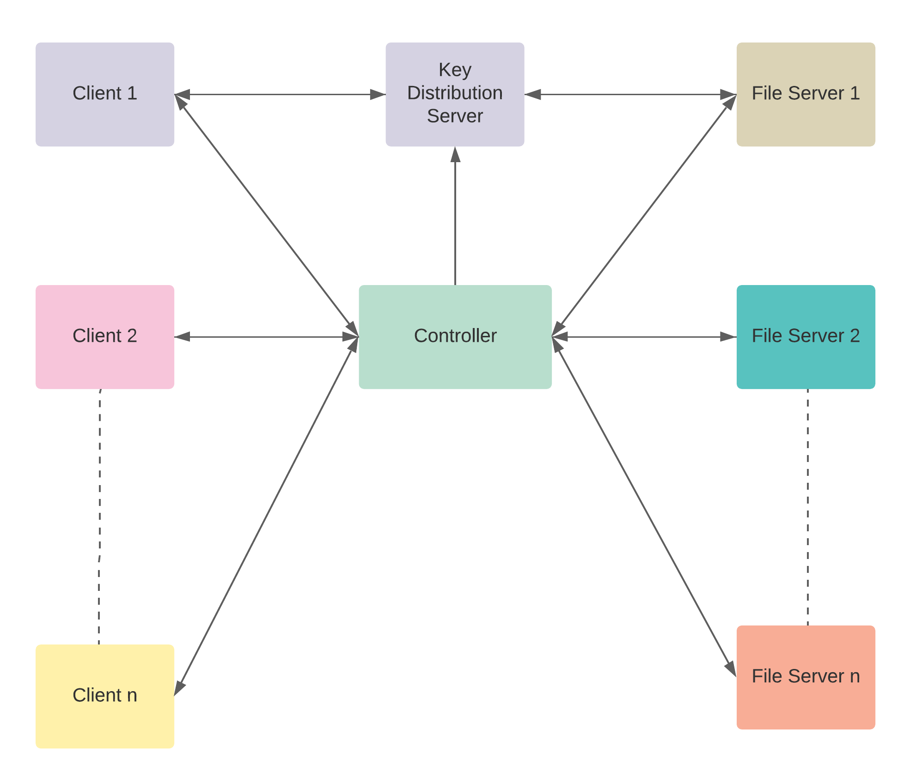
Main flow

Slide 7
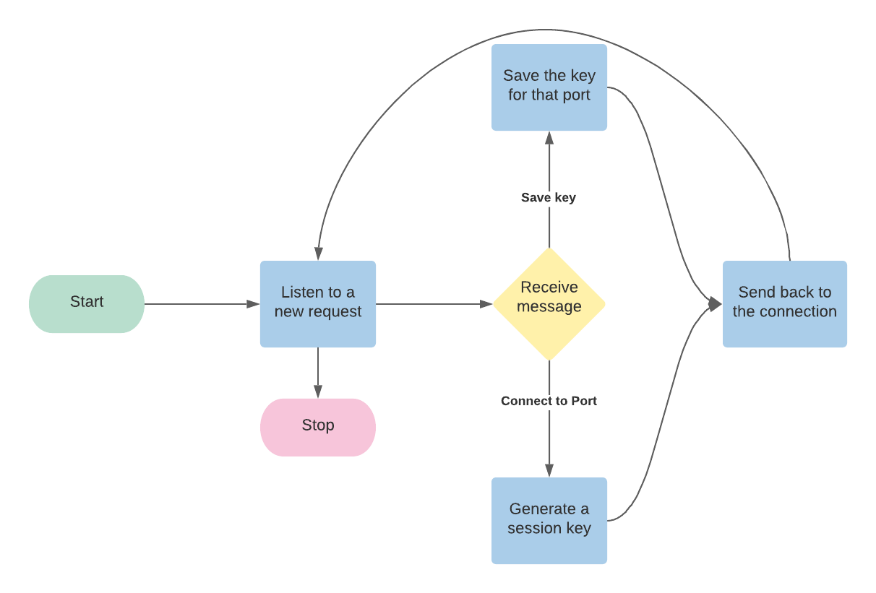
KDC
Used to store private keys or unique ids of each file server and client server
The key passing is done using Needham Schrodinger Protocol
For each file server and client server to start, it has to be registered on KDC.

Slide 8
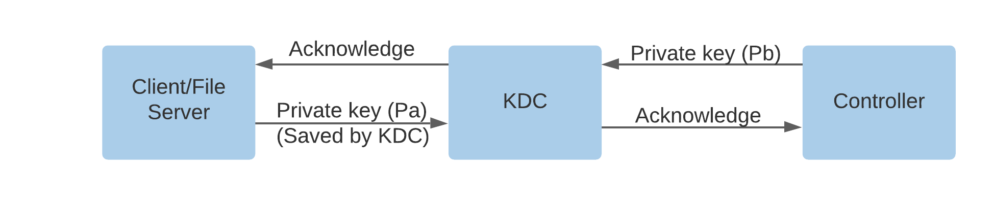
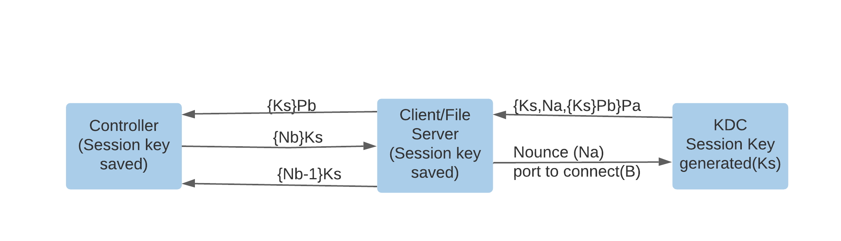
Pa – Private key known only to KDC and Client/File Server
Pb - Private key known only to KDC and Controller
Ks – Session Key generated for session between Client/File Server and Controller
Na,Nb – nounces generated by Client and Controller respectively
Needham Protocol

Slide 9
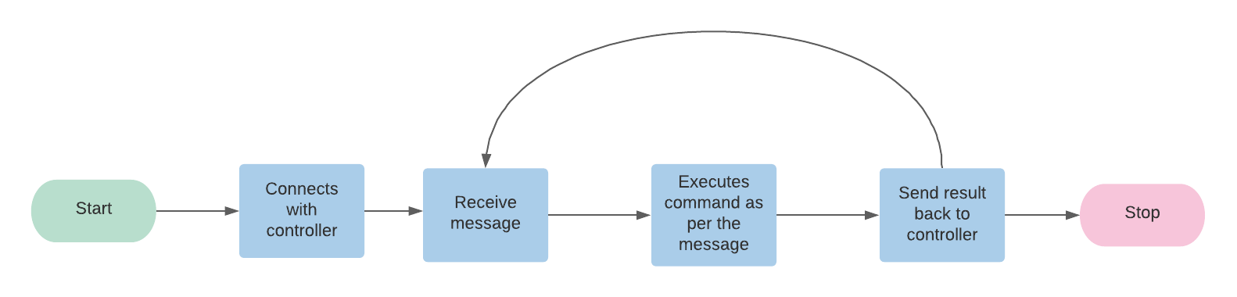
File Server
Unique port number and session key for each file server
Request the controller to know which commands
needs to be executed
Sends the result back to the controller when done
On getting closed, it gets deleted from the list of available file severs for clients by sending command to the controller

Slide 10
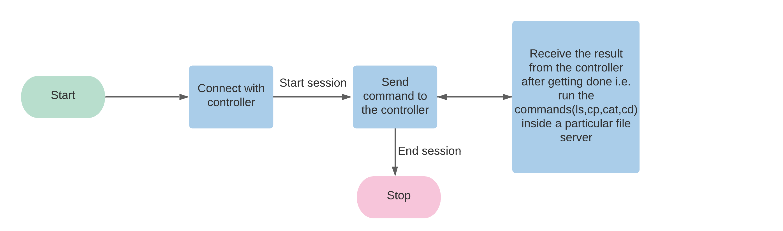
Client
For each client to start, there will be a new session and session key by KDC.
When started, can access the file servers through controller
Send the command to be executed to the controller and receive the result after getting done
To end a session for a client, Enter end.

Slide 11
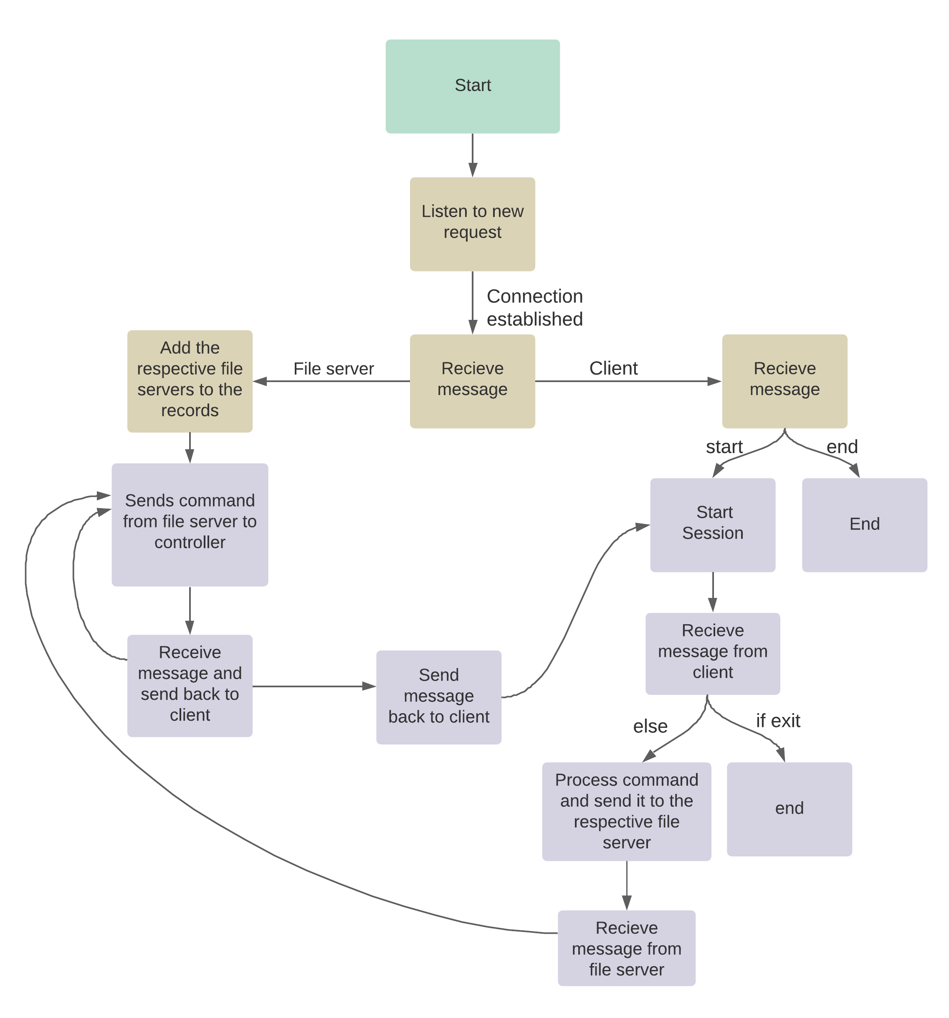
Controller
Connects file servers and client servers with each other
Unique session key b/w file server &
controller and client & controller
The clients make a request to the controller, the controller checks the request, then forwards it to the respective file server.
The file server then responds with the required data, which is then passed to the client.

Slide 12
Demo

Slide 13
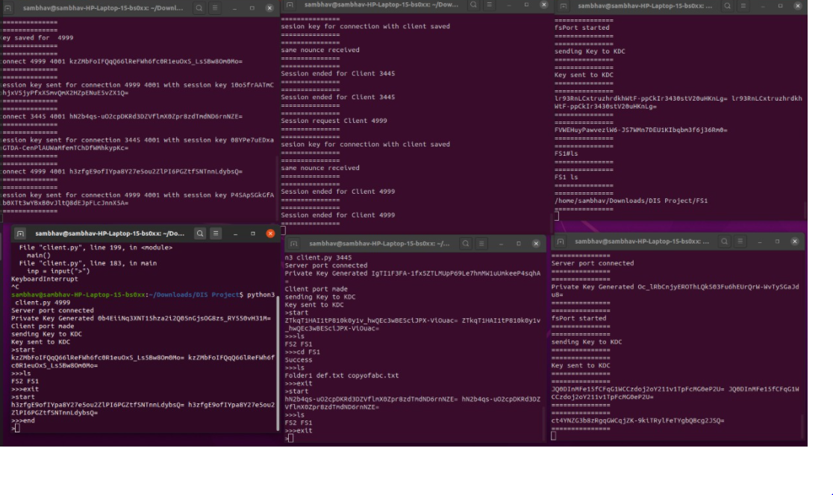
OuTPUT

Slide 14
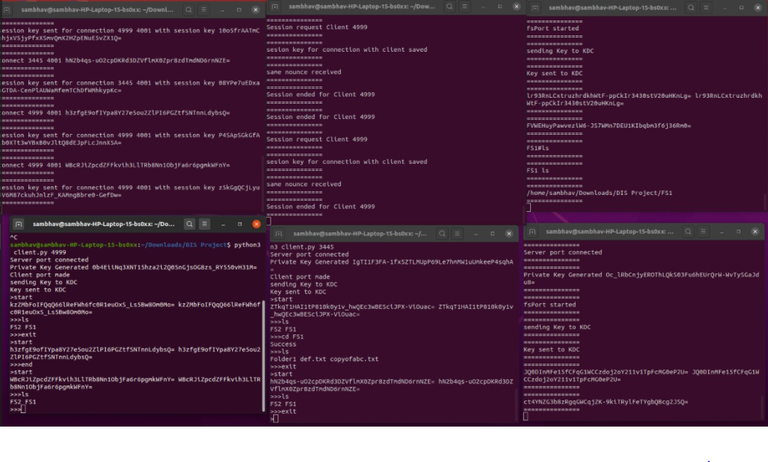

Slide 15
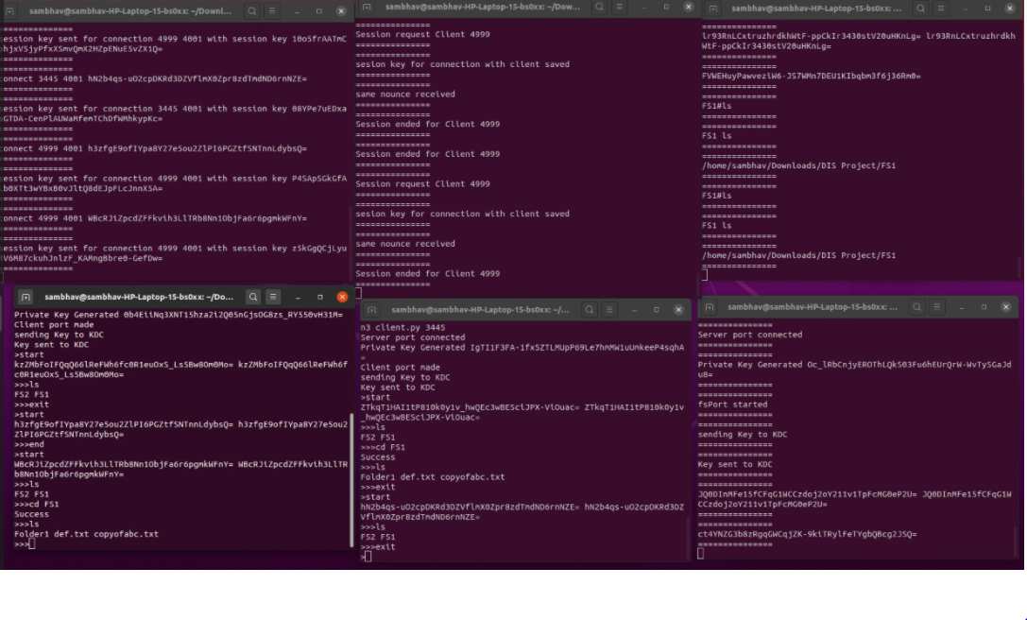

Slide 16
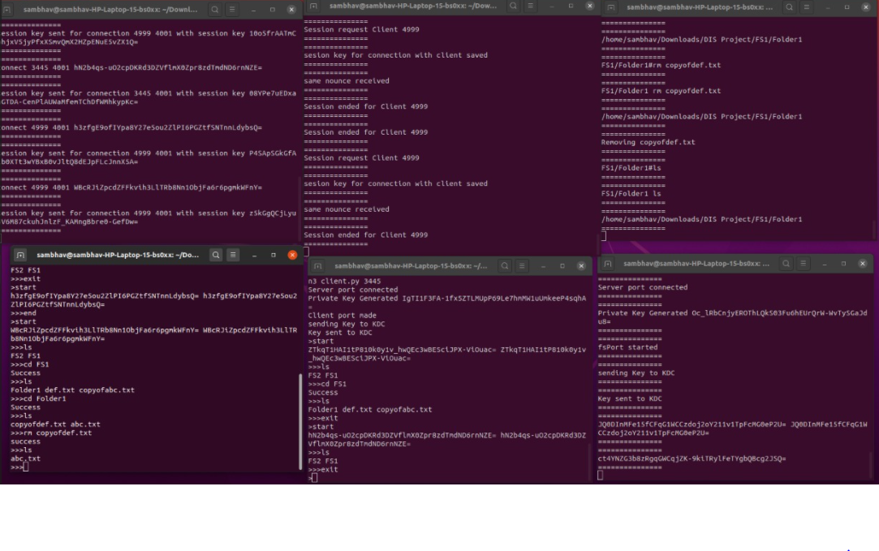

Slide 17
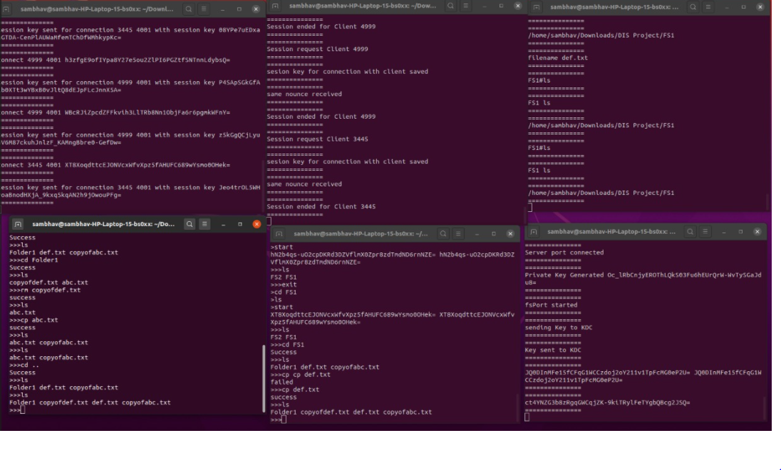

Slide 18
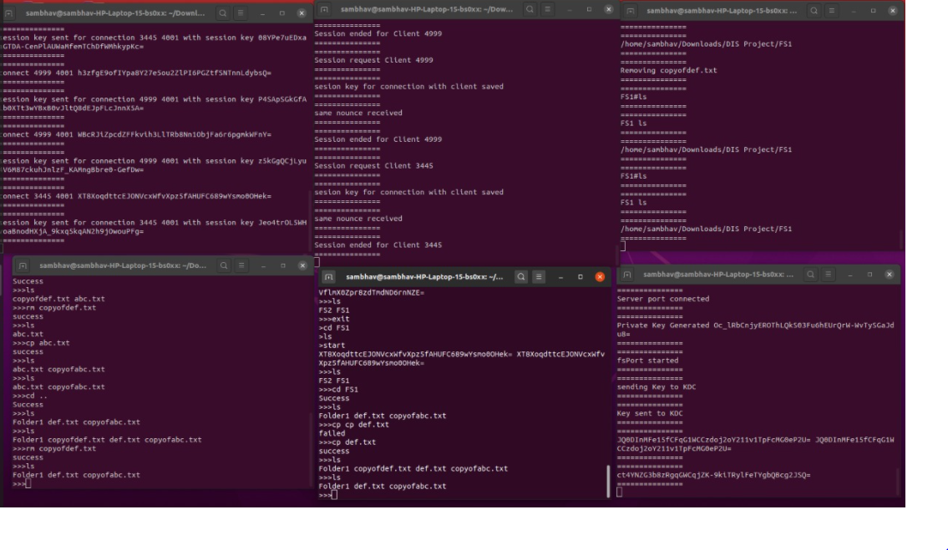

Slide 19
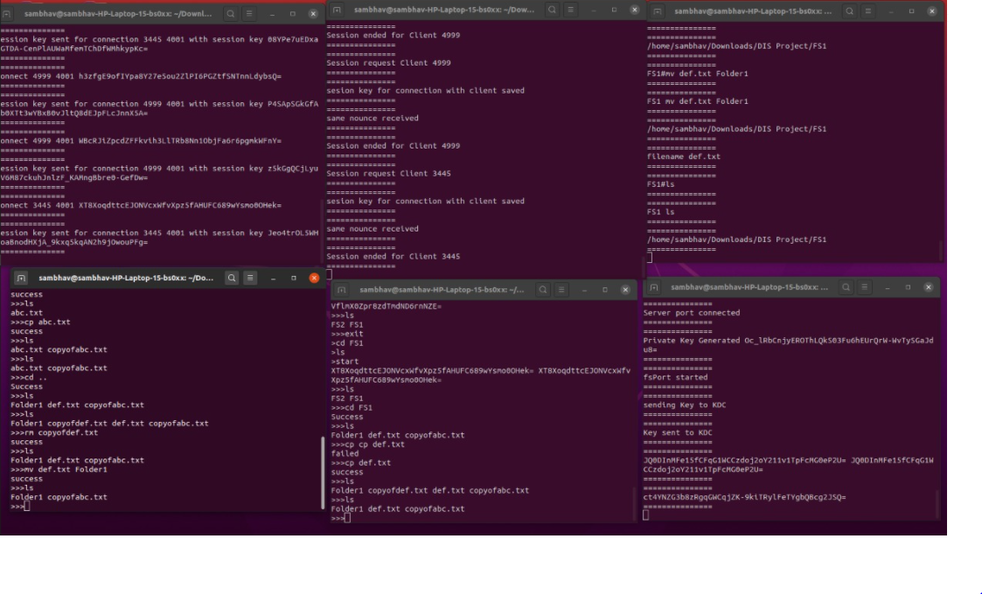

Slide 20
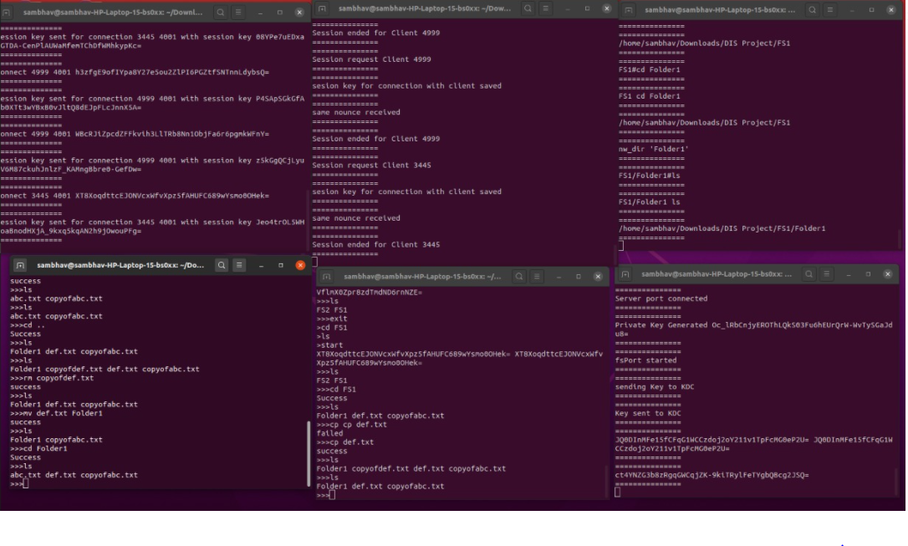

Slide 21
Code Explanation & Q/A

Slide 22
Thank You

